Slide 1
Rust eBPF
Final report
刘般若
2022.12.23

Slide 2
Motivation
Notes:
起完名字，接下来就是做整体的设计。

Slide 3
eBPF only used in rCore OS
Ideally, any OS written in Rust can reuse previous efforts, with minimal modification.
Kernel
BPF Maps
Helper Function
User Space
User program
Data
Context
kprobe
….
eBPF native code
Verifier & JIT compiler
BPF program
OS “Independent” part

Slide 4
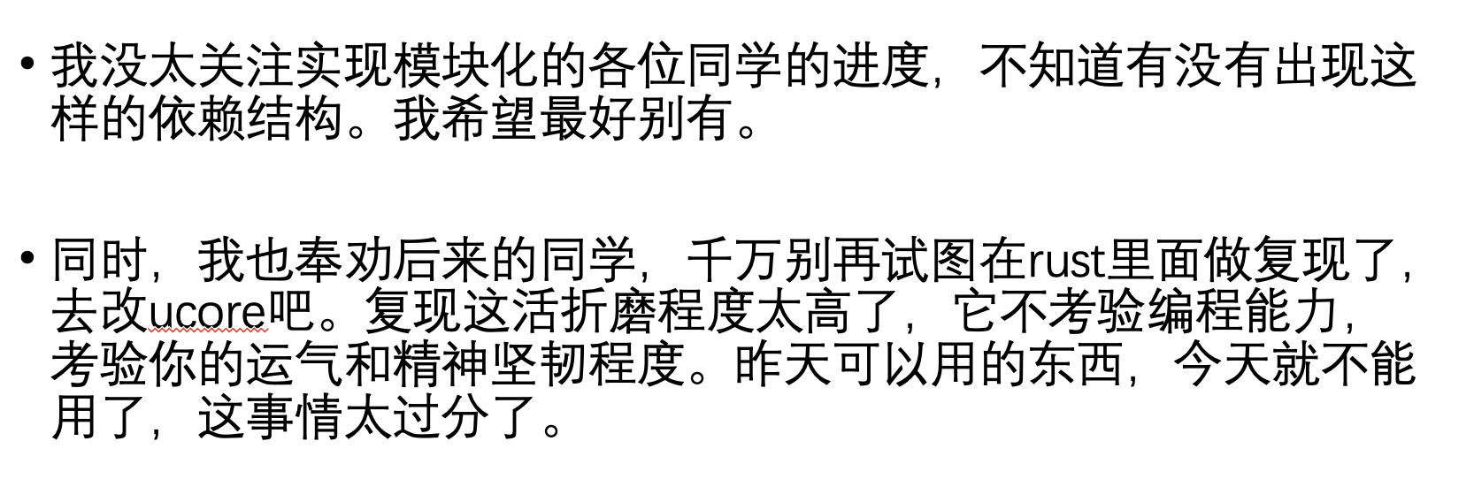
We need detailed document to reproduce
只能说，nighty 它的名字就意味着不可能是“工业级别稳定”。 从现在人人都用 nightly 版本的状况来看，要跟上 Rust 的版本更新本身就是一个非常大的维护开销。 这种东西也不是说自己项目管理做好了就可以的，而是你想要更新你必须确保你所用的所有库都可以顺利更新。 谷歌不知道，rCore 的依赖库有多少 fork 过来的现在都抛荒了都。

Slide 5
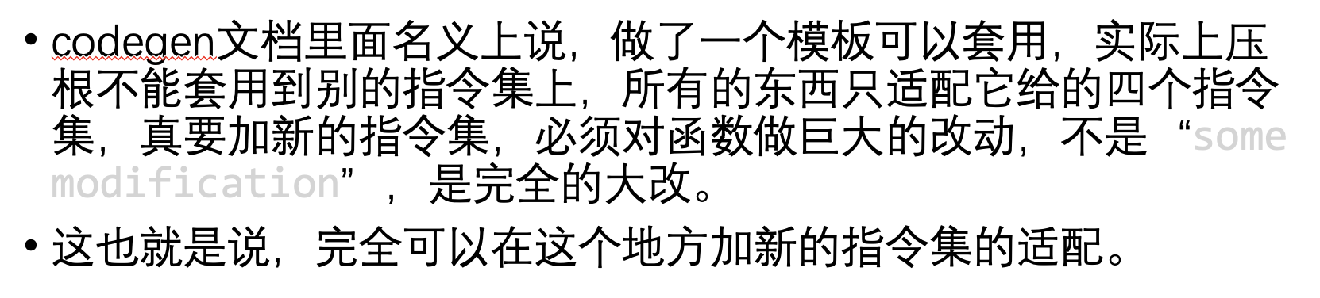
“Reusable” code does not have to be a crate

Slide 6
Our work
Make eBPF utility decouple from OS, but not necessarily a “crate”
Reimplement eBPF in zCore
Migrate modularized eBPF in tutorial-2022A
Write detailed documents for eBPF implementation
A reference as well as a tutorial
Reproduceable
Explore possible future work

Slide 7
Ideas about decouple
pub trait ThreadLike : DowncastSync {
fn get_pid(&self) -> u64;
fn get_tid(&self) -> u64;
fn get_name(&self) -> String;
}
pub fn os_current_thread() -> Arc<dyn ThreadLike> {}
pub fn os_get_current_cpu() -> u8 {}
pub fn os_console_write_str(s: &str) {}
How to run an eBPF program?
User program
Syscall interface
Hookpoint support
eBPF utility
What utility are needed from OS?
A thread abstract
Memory
Other helper functions

Slide 8
zCore eBPF
Reimplemented eBPF utility based on previous work
Decoupled based on previous slide
Restructured BPF map inplementation
Based on kProbe with symbol table support (by ssf)
Fix an upstream bug in rsicv JIT crate
Migrate to rCore tutorial: does those abstract suffice?

Slide 9
Whether kernel shares page table with user?
// rcore
pub fn os_copy_from_user
(usr_addr: usize, kern_buf: *mut u8, len: usize)
-> i32 {
use crate::mm::translated_byte_buffer;
use crate::task::current_user_token;
let t = translated_byte_buffer(current_user_token(), usr_addr as *const u8, len);
let mut all = vec![];
for i in t {
all.extend(i.to_vec());
}
copy(kern_buf,
all.as_ptr() as *const u8, len);
}
// zCore
pub fn os_copy_from_user(
usr_addr: usize,
kern_buf: *mut u8,
len: usize) -> i32 {
let usr_ptr =
usr_addr as *const u8;
copy(kern_buf,
usr_ptr,
len);
}

Slide 10
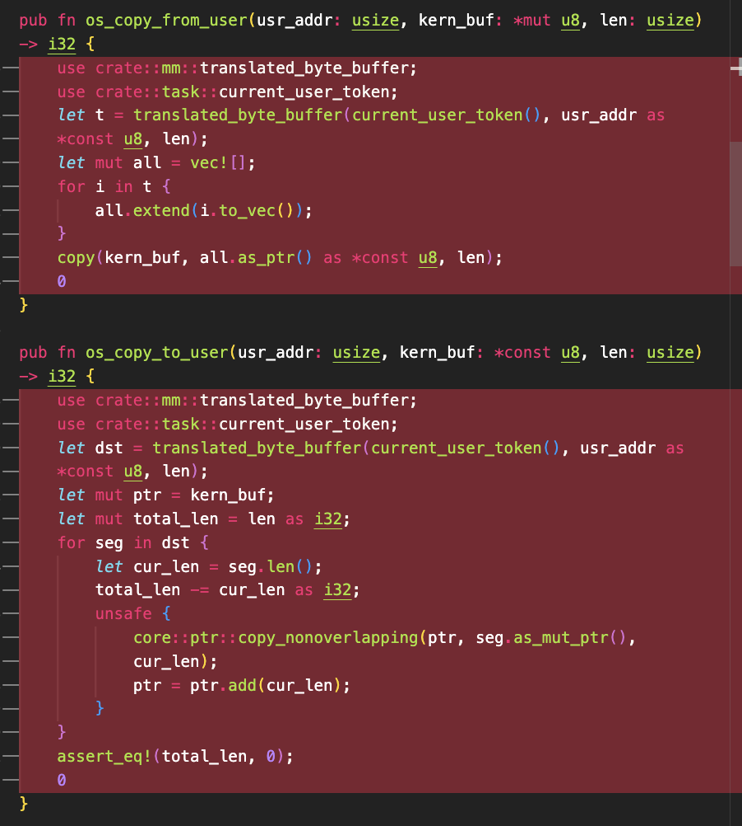
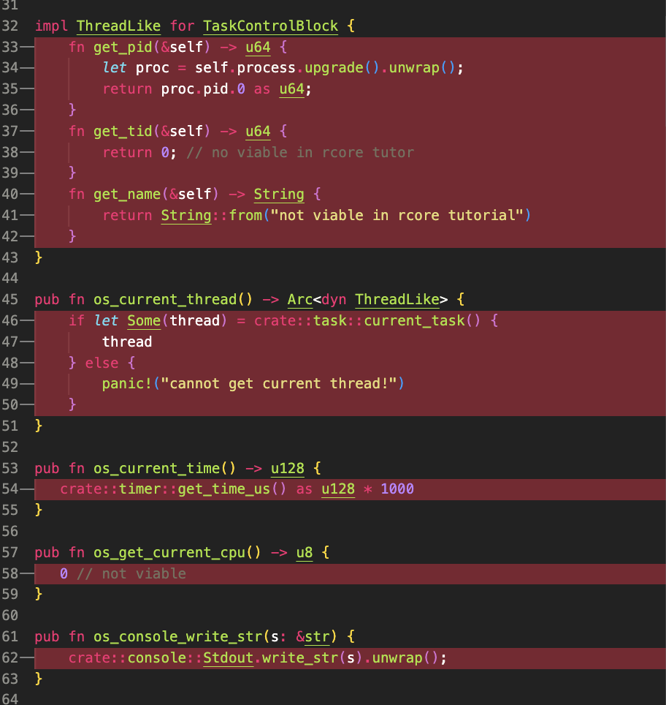
rCore Tutorial 2022A migration
Code change
syscall : 30 LOC
osutil 50 LOC
total : < 100 LOC
(exclude user program)

Slide 11
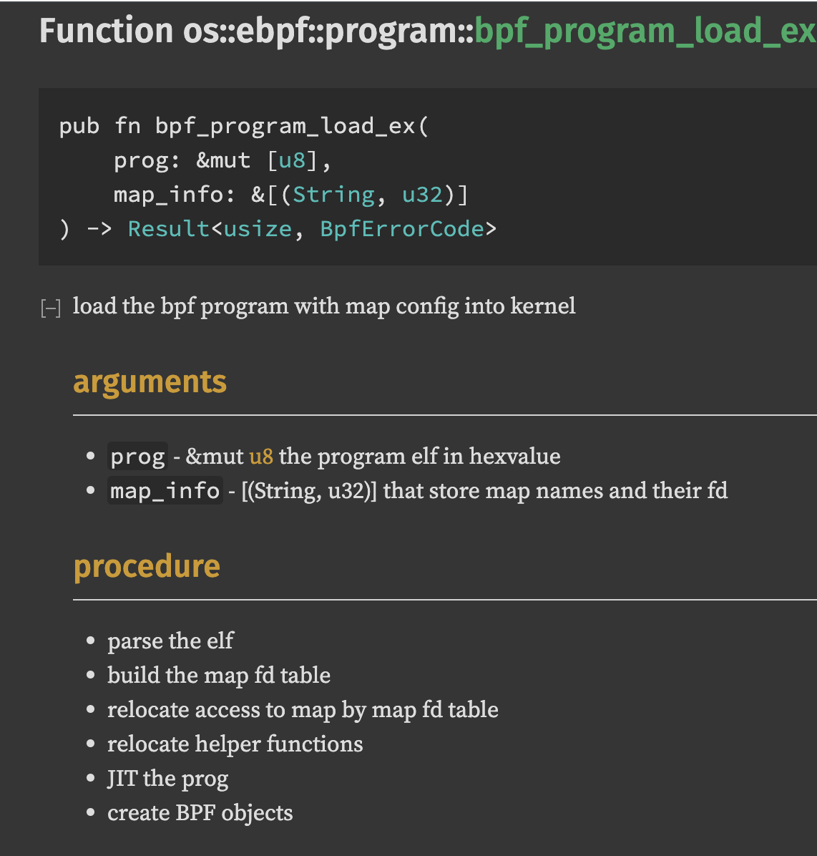
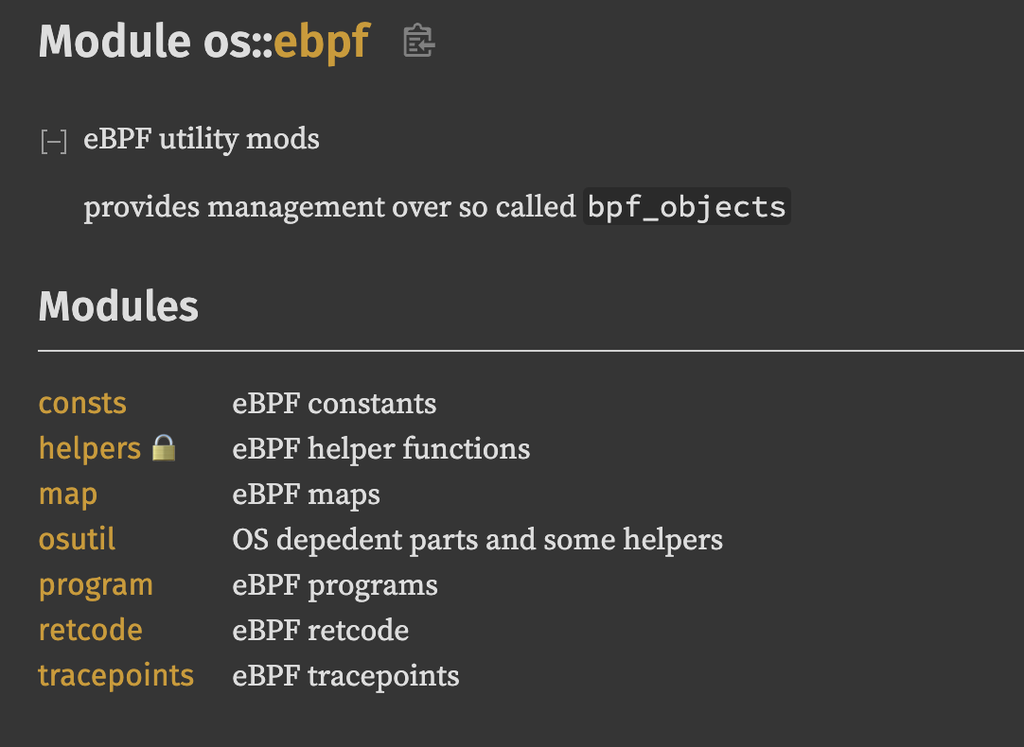
Document
Source code level documentation

Slide 12
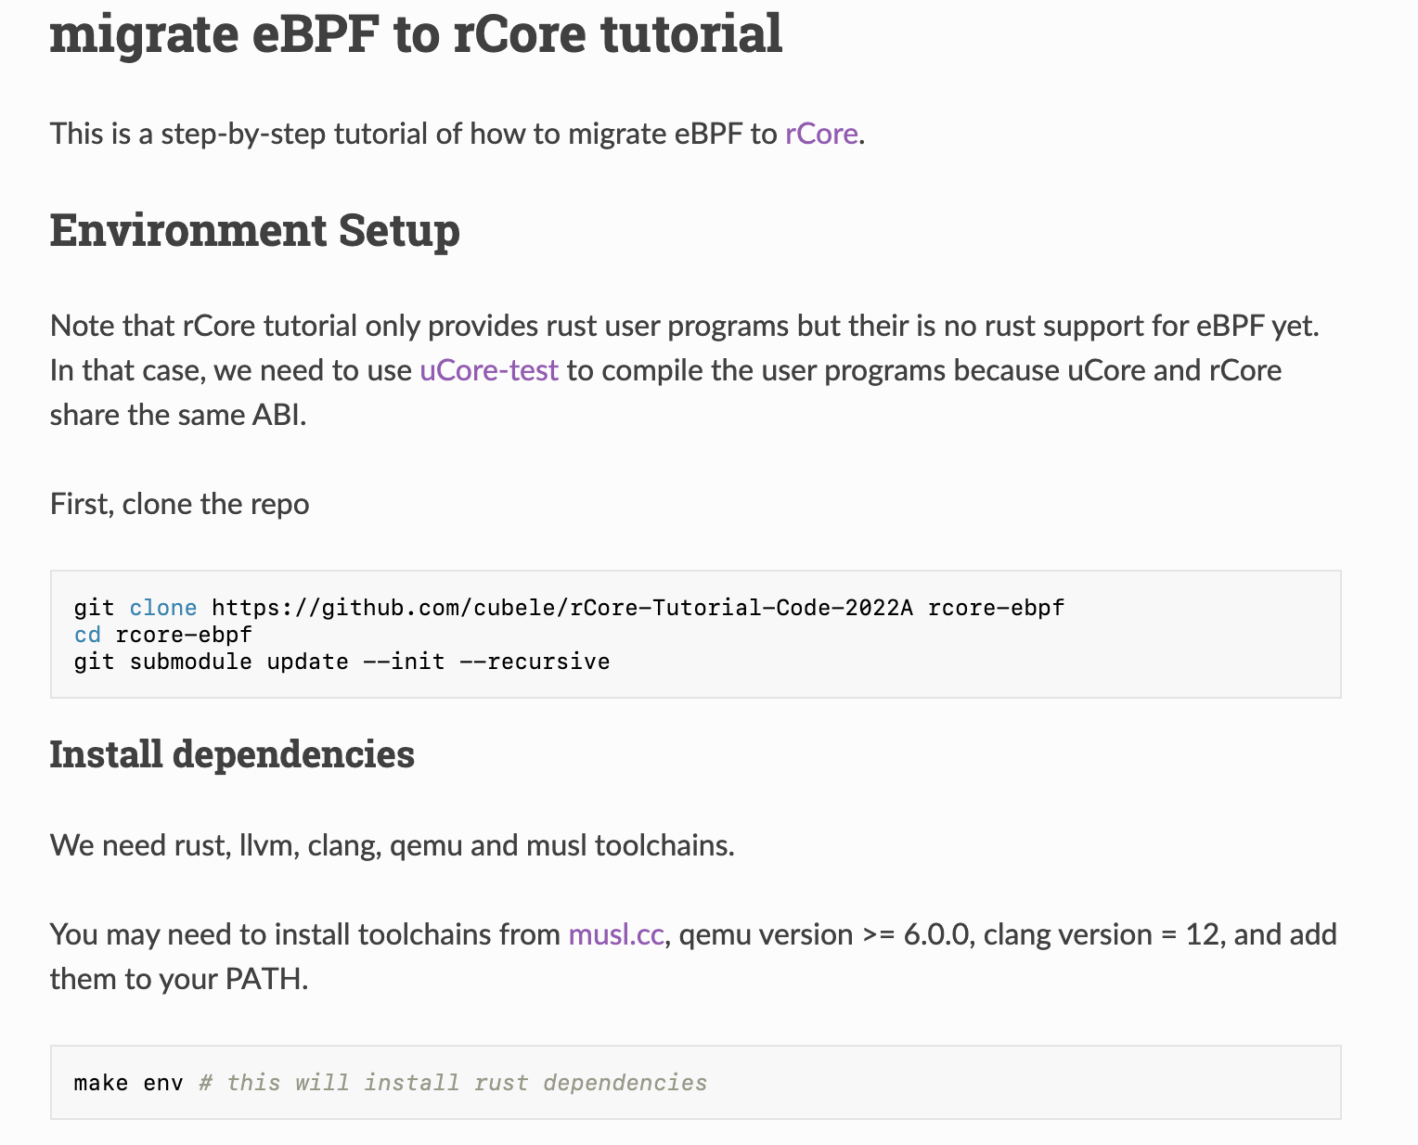
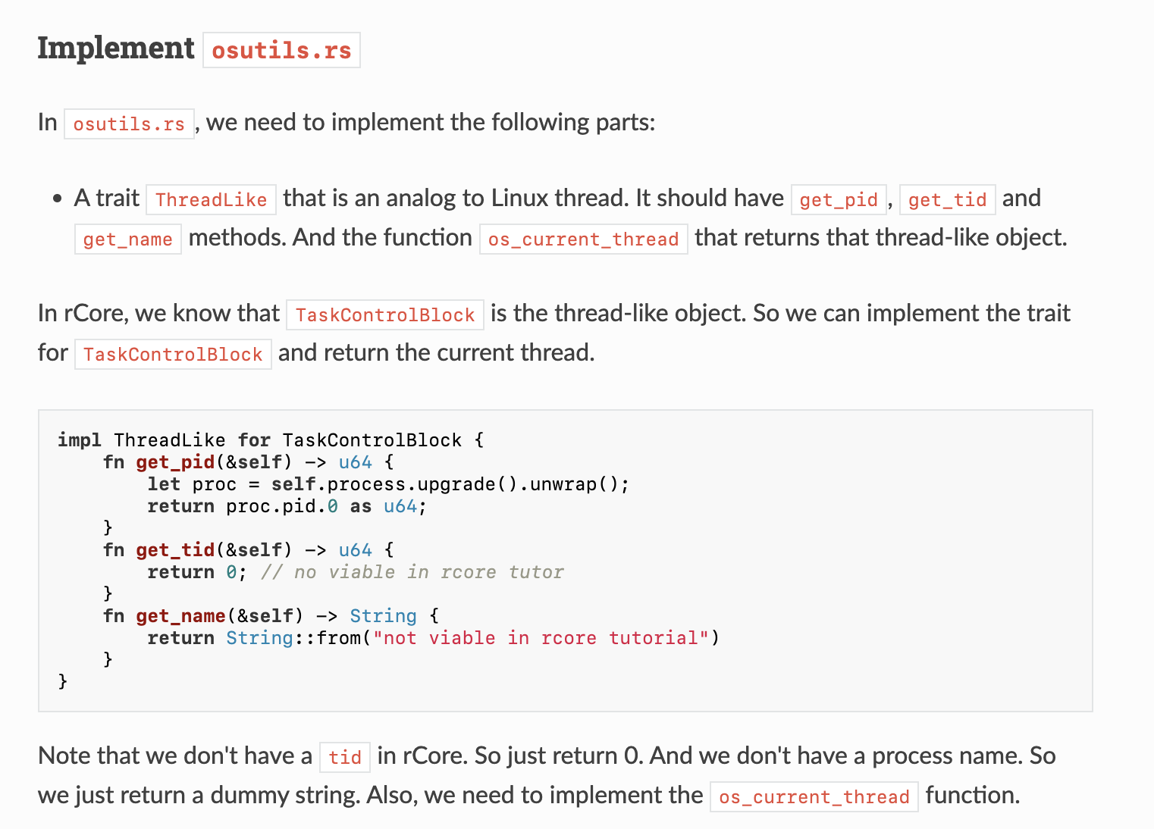
Document
A step-by-step tutorial [https://livingshade.github.io/ebpf-doc/rcore/]

Slide 13
Exploration
In mid term, I try to support more “linux-styled” program
// kern.c
struct {
__uint(type, BPF_MAP_TYPE_ARRAY);
__type(key, int);
__type(value, u64);
__uint(max_entries, MAX_CPU);
} map SEC(".maps");
SEC("kprobe/trace_preempt_off")
int bpf_prog1(struct pt_regs *ctx)
{
int cpu = bpf_get_smp_processor_id();
u64 *ts =
bpf_map_lookup_elem(&map, &cpu); if (ts)
*ts = bpf_ktime_get_ns(); return 0;
}
// user.c
int main(int argc, char **argv)
{
struct bpf_program *prog;
struct bpf_object *obj;
int map_fd, i = 0;
obj =
bpf_object__open_file
("%s_kern.o", NULL);
bpf_object__load(obj)
map_fd = bpf_object__find_map_fd_by_name
(obj,"my_lat");
bpf_object__close(obj);
return 0;
}

Slide 14
Exploration
struct bpf_map_def SEC("maps") xdp_stats_map = {/*…*/}
SEC("prog")
int kern_prog(struct xdp_md *ctx) { u32 key = 1;
int *rec = 0;
rec = bpf_map_lookup_elem
(&xdp_stats_map, &key);
if (!rec)
return -1;
++*rec;
return 0;
}
0000000000000000 kern_prog:
0: b7 01 00 00 01 00 00 00 r1 = 1
1: 63 1a fc ff 00 00 00 00 *(u32 *)(r10 - 4) = r1
2: bf a2 00 00 00 00 00 00 r2 = r10
3: 07 02 00 00 fc ff ff ff r2 += -4
4: 18 01 00 00 00 00 00 00 00 00 00 r1 = 0 ll
0000000000000020: R_BPF_64_64 xdp_stats_map
6: 85 00 00 00 01 00 00 00 call 1
7: 18 01 00 00 ff ff ff ff 00 00 00 00
r1 = 4294967295 ll
9: 15 00 04 00 00 00 00 00
if r0 == 0 goto +4 <LBB0_2>
10: 61 01 00 00 00 00 00 00 r1 = *(u32 *)(r0 + 0)
11: 07 01 00 00 01 00 00 00 r1 += 1
12: 63 10 00 00 00 00 00 00 *(u32 *)(r0 + 0) = r1
13: b7 01 00 00 00 00 00 00 r1 = 0
Requires a customer user space ELF parser!
Or, follow convetion in Linux document

Slide 15
Future works
User space “libbpf”
Improve [eBPF to riscv] JIT compiler
Try different hook points
Migrate to other Rust-based OS

Slide 16
Credits
Shisheng20 for adding Kprobe utility and teaching me how to use qemu.
Yesheng19 for his comments in eBPF relocation and efforts in reproducing latte-c’s work.
Teacher Xiang and teacher Chen for their enlightening advice.
TA’s timely reply about issues regarding zCore

Slide 17
Q&A
Thanks for your attention!
https://github.com/cubele/zCore
https://github.com/cubele/rCore-Tutorial-Code-2022A
https://livingshade.github.io/ebpf-doc
Notes:
我的分享也至此结束，谢谢大家。

